Slide 1
Hands Free Future

Slide 2
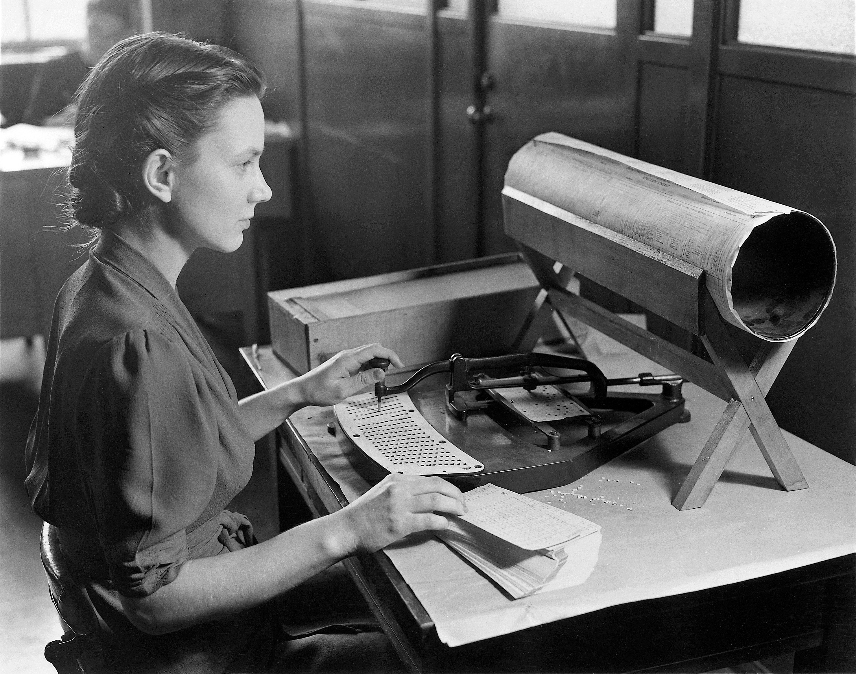
1945
1945
1945
1945
1945
1945
1945
1968
1945
1945

Slide 3

1969
1945
1945
1945
1945
1945
1945
1945
1945
1968

Slide 4
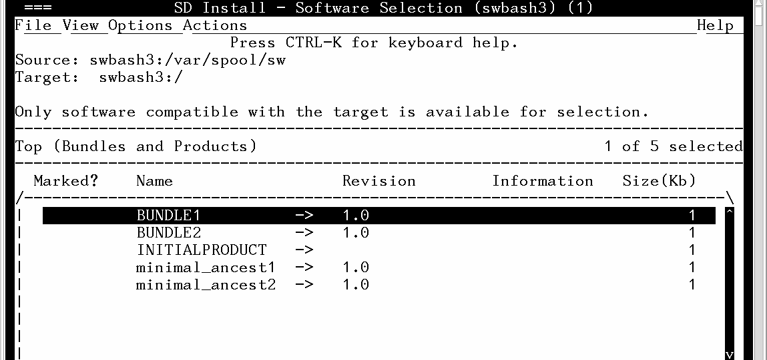
1945
1945
1945
1945
1945
1945
1945
1968
1945
1945

Slide 5
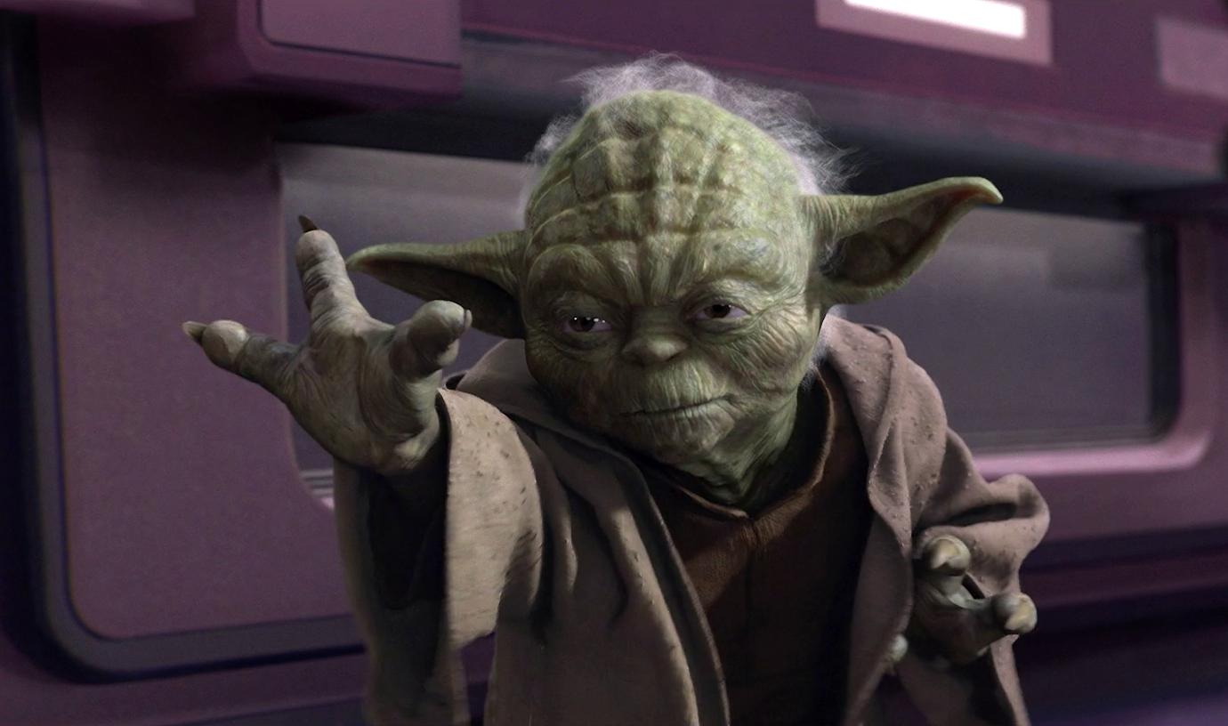
uSe the Force

